Slide 1


Detecting Phishing Emails
Lincoln Brown
Project 3 Milestone 3
DSC680-T301
Professor Iranitalab

Slide 2

Background
The Problem:
Phishing emails are a major cybersecurity threat for both users and organizations that can result in financial losses, data breaches, and compromised systems.
The Opportunity:
Utilizing machine learning models to identify phishing emails, organizations can prevent these emails from reaching the end user, thereby reducing the security risk.

Slide 3

Dataset
The dataset used in this project is the Phishing Email Detection found on Kaggle, uploaded by user Cyber Cop. This dataset contains two features: Email Text and Email Type. The email text feature contains the body of the email, and the email type is the associated classification label phishing or safe.

Slide 4
Methods
This project built and evaluated the following models for detecting phishing emails:
Logistic Regression
Bidirectional Encoder Representation (BERT) model

Slide 5

Performance Metrics
The following performance metrics were used to evaluate performance:
Accuracy: The proportion of all classifications, both phishing and legitimate, that were correct.
Precision: The proportion of phishing classified as phishing by the model that were phishing.
Recall: The proportion of all actual phishing emails that the model correctly identified as phishing.
F1 Score: The harmonic mean of precision and recall, balancing the trade-off between false positives and false negatives.
Area Under the Receiver Operating Characteristic (ROC-AUC): A measure of the model's ability to differentiate between phishing and legitimate emails.

Slide 6
Model Results
Logistic Regression Model
Accuracy | 0.9775
Metric | Class 0 (Negative) | Class 1 (Positive) | Macro Avg | Weighted Avg
Precision | 0.98 | 0.98 | 0.98 | 0.98
Recall | 0.99 | 0.96 | 0.97 | 0.98
F1-Score | 0.98 | 0.97 | 0.98 | 0.98
Support | 2008 | 1280 | 3288 | 3288
BERT Model
Accuracy | 0.9857
Metric | Class 0 (Negative) | Class 1 (Positive) | Macro Avg | Weighted Avg
Precision | 0.99 | 0.98 | 0.99 | 0.99
Recall | 0.99 | 0.98 | 0.98 | 0.99
F1-Score | 0.99 | 0.98 | 0.98 | 0.99
Support | 2008 | 1280 | 3288 | 3288

Slide 7
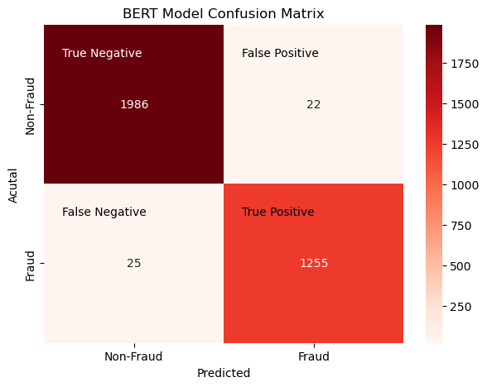

Confusion Matrices
Notes:
Here we can see the confusion matrices for both models.
We are looking primarily at the False Negatives and False Positives for each model, as these were the emails that were incorrectly labeled.
We can see that the BERT model performed better than the Logistic Regression model in both categories. Notably, the BERT model only incorrectly labeled 25 phishing emails as legitimate, whereas the Logistic Regression model labeled 48 phishing emails as legitimate. This is a problem because in a real-world deployment, these emails would reach the end user and introduce a potential vector of attack.
Additionally, looking at the False Positives, we can see that the BERT model incorrectly labeled 22 legitimate emails as phishing emails and the Logistic Regression model incorrectly labeled 26. False positives mean that legitimate emails that should reach the end user will be filtered as spam.
This can have direct implications on the end users' ability to perform their duties.

Slide 8

Challenges
BERT model is computationally expensive and has a long training time
Notes:
The most notable challenge of this project was the long and computationally expensive training time of the BERT model. This is important for implementation because businesses need to consider whether they have the necessary resources to support BERT.

Slide 9

Implementation Plan
Key Factors:
Computational Resources
Data Source & Deployment
Model Maintenance
Staffing & Support
Notes:
Businesses need to consider 4 key factors when deciding which model they would choose to implement. These factors are:
What computational resources available, where the training data will come from, how the model will be maintained, and what staff the business has available to manage and maintain the model.

Slide 10

Ethical Considerations
This project had limited ethical implications. The dataset used is publicly available and licensed under the GNU Lesser Public License 3.0. The dataset did not contain any private email addresses or metadata information from the emails. Implementing phishing email detection models in business environments can introduce privacy concerns that need to be properly addressed to avoid any potential leaks of Personally Identifiable Information (PII).

Slide 11
Conclusion
Conclusion: Combining ML models with end-user training can enhance phishing detection and reduce organizational risk
Results:
Logistic Regression: 97.75% accuracy, fast computation
BERT: 98.57% accuracy, higher computational cost
ROC AUC: Both models achieved 99%, indicating strong classification capability
Key Takeaways:
BERT is ideal for high-performance environments despite its computational cost
Logistic Regression is a strong, efficient alternative for businesses with limited resources
Neither model guarantees 100% detection – it is essential to mitigate risk with user training

Slide 12
Questions
How does the BERT model compare to Logistic Regression in terms of accuracy and performance? BERT model performs better than Logistic Regression in terms of accuracy, achieving a score of 98.57% vs Logistic Regression’s score of 97.75%. However, BERT comes at a higher computational cost.
What is the primary difference between the Logistic Regression and the BERT models, why did you use both? Logistic Regression is a simpler, linear model that uses word-frequencies, while BERT is a transformer-based model that understands contextual word meanings. Both models were used to evaluate the trade-off between simplicity and accuracy.
What specific features from the email data did you use to train the model? The models used tokenized words from the email message body as the train feature.
How does the model handle new phishing techniques that it has never seen before? Both models may struggle to perform on new, unseen phishing messages. However, retraining the models may provide improved performance on new techniques.
Can the model be integrated into existing email systems? If so, how? Integration would be possible by adding either model to the email filtering pipeline, where it can scan the emails and predict the email is phishing or legitimate.
How does the model balance false positives and false negatives? Are there trade-offs in these rates? The model aims to reduce both false positives and negatives, but there is an inherent trade off in reducing one rate over the other. Prioritizing false negatives means that more legitimate emails could be classified as phishing, and prioritizing false positives means that more phishing emails could be classified as legitimate.
What challenges did you encounter while working with this dataset? The biggest challenge encountered with working with this dataset was the amount of time it took to train the BERT model.
How do the models handle variations in the language used in phishing emails, such as slang or different writing styles? BERT is better at handling variations in the language used, whereas Logistic Regression may struggle unless the dataset contains diverse examples of the patterns used.
Can this model be deployed for real-time phishing detection? Due to the changing nature of phishing emails, I would not recommend deploying either model into a production system without retraining the models on a current dataset.
How could the performance of these models be improved? Incorporating more features from an email, such as the presence of external URLs, sender email information, header information, etc. would give the model more features to train on and would likely improve performance.

Slide 13
References
Albon, C. (2018). Machine Learning with Python Cookbook: Practical Solutions from Preprocessing to Deep Learning.
Erim, E. (2024, March 26). Complete guide to building a text classification model using BERT. Medium. https://medium.com/@emreerim_65318/complete-guide-to-building-a-text-classification-model-using-bert-abf27b5cb6a1
GeeksforGeeks. (2024, December 10). BERT Model NLP. GeeksforGeeks. https://www.geeksforgeeks.org/explanation-of-bert-model-nlp/
GeeksforGeeks. (2025, February 3). Logistic regression in machine learning. GeeksforGeeks. https://www.geeksforgeeks.org/understanding-logistic-regression/
Phishing email Detection. (n.d.). https://www.kaggle.com/datasets/subhajournal/phishingemails
Science, D. (2023, July 5). Building text classification models using BERT. Data-Driven Science. https://datadrivenscience.com/building-text-classification-models-using-bert/

